Slide 1
DBSCAN Density-based Spatial Clustering of Applications with Noise
A presentation by:
Shantan Hastalpuram
Sanketh Sreedharan Muthu
Prem Kumar Bodasingi
Instructor: Prof. Yasser Alginahi
Date: 10-Nov-2023

Slide 2
Agenda
Introduction to clustering
Terms in the abbreviation
DBSCAN – Introduction and history
Why do we need DBSCAN
Further explanation
Examples and use cases
References

Slide 3
Machine Learning
Supervised Learning
Unsupervised Learning
Reinforcement Learning
Clustering

Slide 4
Machine Learning
K-Means Clustering
Hierarchical Clustering
Unsupervised Learning
Clustering
DBSCAN

Slide 5
Introduction to clustering
Clustering – grouping unlabelled data into groups/clusters
Example is identifying calls you receive and grouping them into important, casual, spam, marketing or scam.
Clustering is done to know more about the data, analyze the data, and recognize patterns if any.

Slide 6
Terms in the abbreviation
Density
The concentration of points in a region
Clustering
Noise
More than 2-dimensional data
Spatial
Data which does not fall into any clusters at first glance

Slide 7




DBSCAN – Introduction and history
proposed by Martin Ester, Hans-Peter Kriegel, Jörg Sander and Xiaowei Xu in 1996
[Source: https://tinyurl.com/2zs9n6p8.]

Slide 8
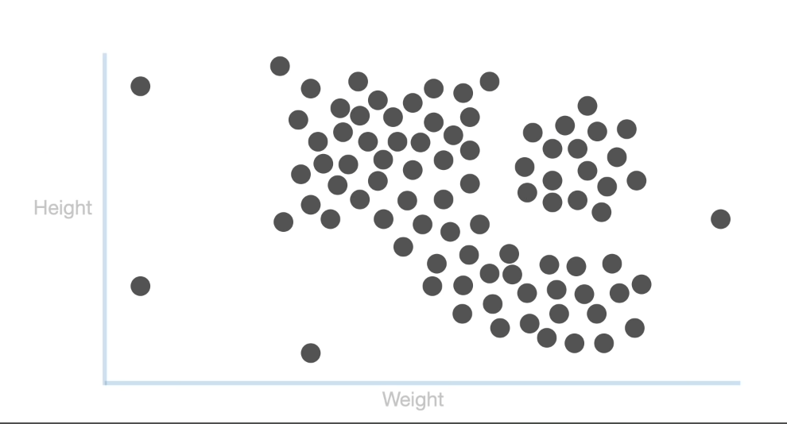
Why do we need DBSCAN
DBSCAN – clusters just like a person can
All examples considered for explanation are 2-dimensional
[Source:https://youtu.be/RDZUdRSDOok]

Slide 9
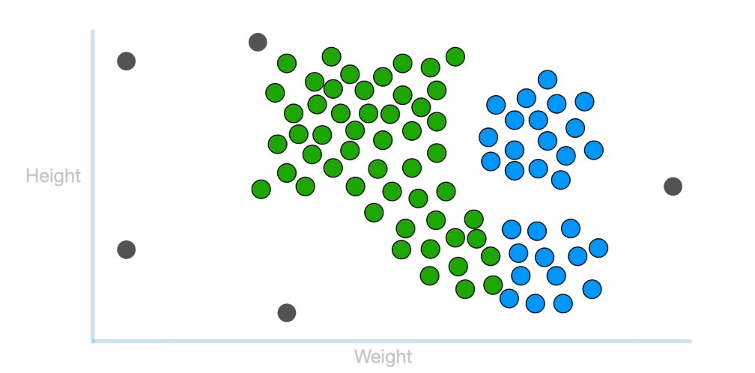
Why do we need DBSCAN
[Source:https://youtu.be/RDZUdRSDOok]

Slide 10
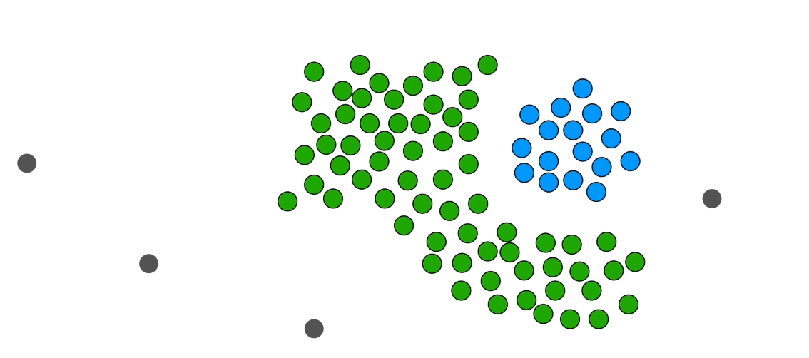
Why do we need DBSCAN
In addition, it is robust to outliers
[Source:https://youtu.be/RDZUdRSDOok]

Slide 11
Reachability and Connectivity
These are the two concepts you must comprehend before proceeding.
Reachability
Connectivity.
Two points in DBSCAN can be referred to in terms of reachability and connectivity:
Directly Density-Reachable
Density-Reachable
Density-Connected

Slide 12
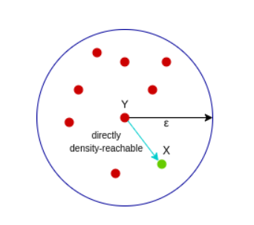
Directly Density-Reachable
A point X is directly density-reachable from point Y with repsect to epsilon, minPoints if.
X belongs to the neighborhood of Y, i.e, dist(X, Y) <= epsilon
Y is a core point
[Source:https://www.analyticsvidhya.com/blog/2020/09/how-dbscan-clustering-works/]

Slide 13
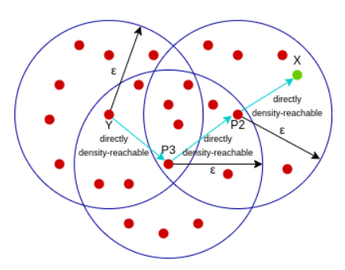
Density-Reachable
A point X is density-reachable from point Y w.r.t epsilon, minPoints if there is a chain of points p1, p2, p3, …, pn and p1=X and pn=Y such that pi+1 is directly density-reachable from pi.
[Source:https://www.analyticsvidhya.com/blog/2020/09/how-dbscan-clustering-works/]

Slide 14
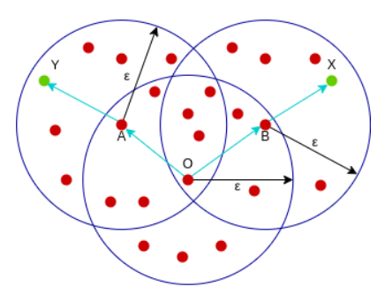
Density-Connectivity
A point X is density-connected from point Y w.r.t epsilon and minPoints if there exists a point O such that both X and Y are density-reachable from O w.r.t to epsilon and minPoints.
[Source:https://www.analyticsvidhya.com/blog/2020/09/how-dbscan-clustering-works/]

Slide 15
Parameter Selection in DBSCAN Clustering
DBSCAN is very sensitive to the values of epsilon and minPoints.
The value of minPoints should be at least one greater than the number of dimensions of the dataset, i.e.,
minPoints >= Dimensions + 1.
The value of epsilon can be decided from the K-distance graph. The point of maximum curvature (elbow) in this graph tells us about the value of epsilon.

Slide 16
Clustering methods
There are three types of clustering methods such as
K Means Clustering
Hierarchical Clustering
DBSCAN Clustering

Slide 17
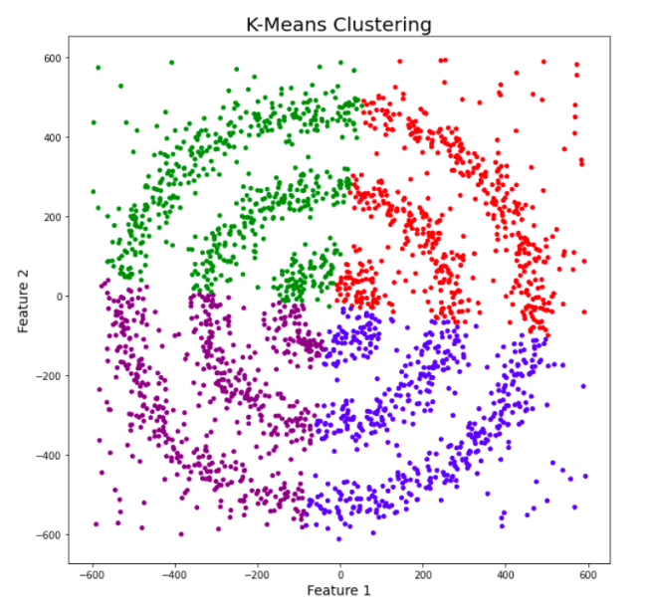
K Means Clustering Method
K-means is a partitioning method that divides a dataset into K clusters.
It minimizes the variance within each cluster, forming clusters around centroids.
[Source:https://www.analyticsvidhya.com/blog/2020/09/how-dbscan-clustering-works/]

Slide 18
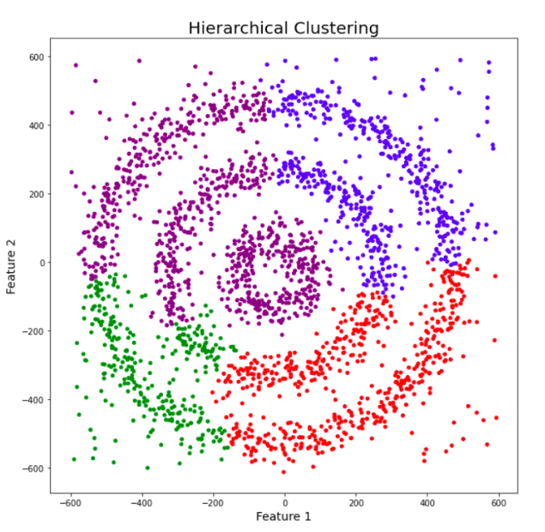
Hierarchical Clustering Method
Hierarchical clustering creates a tree of clusters (dendrogram), representing the relationships between data points.
[Source:https://www.analyticsvidhya.com/blog/2020/09/how-dbscan-clustering-works/]

Slide 19
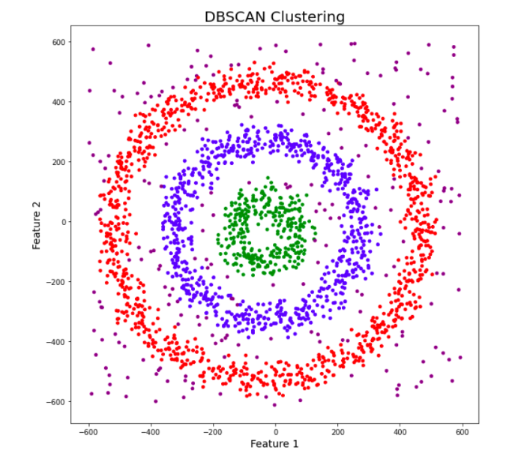
DBSCAN Clustering Method
DBSCAN identifies clusters based on the density of data points.
Effective in discovering clusters of arbitrary shapes.
Robust to noise and outliers.
[Source:https://www.analyticsvidhya.com/blog/2020/09/how-dbscan-clustering-works/]

Slide 20
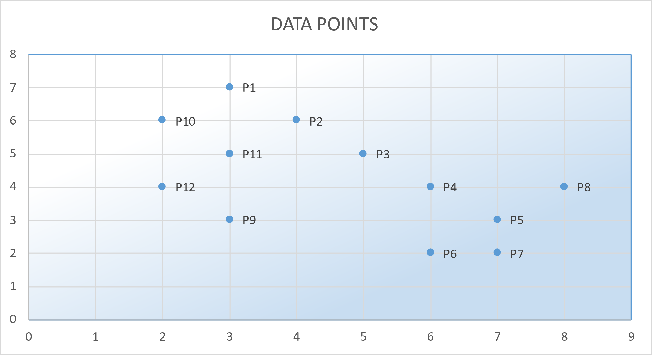
Random unlabeled data
POINTS | X | Y
P1 | 3 | 7
P2 | 4 | 6
P3 | 5 | 5
P4 | 6 | 4
P5 | 7 | 3
P6 | 6 | 2
P7 | 7 | 2
P8 | 8 | 4
P9 | 3 | 3
P10 | 2 | 6
P11 | 3 | 5
P12 | 2 | 4
1. Select random data, shown above
2. Plotting in 2-d Cartesian plan
3. visualising the possible no. of clusters,
[Source:https://www.youtube.com/watch?v=-p354tQsKrs&ab_channel=MaheshHuddar]

Slide 21
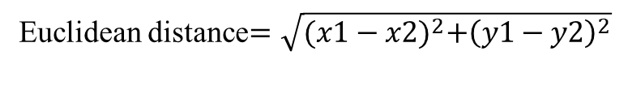
Analysis of the random data
Min_Pts = 4, Epsilon (radius)= 1.9
Euclidean distance$=\sqrt{{{(x1−x2)}^{2}+\left(y1−y2\right)}^{2}}$
P1 : (3,7)
P2 : (4,6)
P3 : (5,5)
P4 : (6,4)
P5 : (7,3)
P6 : (6,2)
P7 : (7,2)
P8 : (8,4)
P9 : (3,3)
P10 : (2,6)
P11 : (3,5)
P12 : (2,4)
 | P1 | P2 | P3 | P4 | P5 | P6 | P7 | P8 | P9 | P10 | P11 | P12
P1 | 0.00
P2 | 1.41 | 0.00
P3 | 2.83 | 1.41 | 0.00
P4 | 4.24 | 2.83 | 1.41 | 0.00
P5 | 5.66 | 4.24 | 2.83 | 1.41 | 0.00
P6 | 5.83 | 4.47 | 3.16 | 2.00 | 1.41 | 0.00
P7 | 6.40 | 5.00 | 3.61 | 2.24 | 1.00 | 1.00 | 0.00
P8 | 5.83 | 4.47 | 3.16 | 2.00 | 1.41 | 2.83 | 2.24 | 0.00
P9 | 4.00 | 3.16 | 2.83 | 3.16 | 4.00 | 3.16 | 4.12 | 5.10 | 0.00
P10 | 1.41 | 2.00 | 3.16 | 4.47 | 5.83 | 5.66 | 6.40 | 6.32 | 3.16 | 0.00
P11 | 2.00 | 1.41 | 2.00 | 3.16 | 4.47 | 4.24 | 5.00 | 5.10 | 2.00 | 1.41 | 0.00
P12 | 3.16 | 2.83 | 3.16 | 4.00 | 5.10 | 4.47 | 5.39 | 6.00 | 1.41 | 2.00 | 1.41 | 0.00
P1 | P2, P10
P2 | P1,P3,P11
P3 | P2,P4
P4 | P3,P5
P5 | P4,P6,P7,P8
P6 | P5,P7
P7 | P5,P6
P8 | P5
P9 | P12
P10 | P1,P11
P11 | P2,P10,P12
P12 | P9,P11
Distance Matrix
4.Finding distance between each individual data point to remaining all data points, using distance formula, plotting in distance matrix
5. Taking each data point as core point finding the number of remaining data points fall in the core region of radius i.e., epsilon= 1.9
Note : To find the remaining points , Eg : consider core point say (P5) using distance matrix
1. From P5 check horizontally how many points are under the eplison value (>=1.9) i.e (P4)
2. From P5 check vertically, how many are falling under the eplison value (>=1.9) i.e (P6,P7,P8)
P5 as core point, P4,P6,P7,P8 are in core region
[Source:https://www.youtube.com/watch?v=-p354tQsKrs&ab_channel=MaheshHuddar]

Slide 22
Results of the analysis
Min_Pts = 4, Epsilon (radius)= 1.9
POINTS | STATUS
P1 | NOISE | BORDER
P2 | CORE
P3 | NOISE | BORDER
P4 | NOISE | BORDER
P5 | CORE
P6 | NOISE | BORDER
P7 | NOISE | BORDER
P8 | NOISE | BORDER
P9 | NOISE
P10 | NOISE | BORDER
P11 | CORE
P12 | NOISE | BORDER
P1 | P2, P10
P2 | P1,P3,P11
P3 | P2,P4
P4 | P3,P5
P5 | P4,P6,P7,P8
P6 | P5,P7
P7 | P5,P6
P8 | P5
P9 | P12
P10 | P1,P11
P11 | P2,P10,P12
P12 | P9,P11
6. The region with minimum 4 data points is consider as core region , since assumed minimum points to be 4 point,
P2, P5,P11 are forming core region ,the rest other considered as noise
7. The noise can some time be border to core region , checking all the Nosie data points whether they are falling in any core region,
P1 is falling in P2 core region , hence P1 is border Point, which can be used to form cluster,
Similarly, P3, P4,P6,P7,P8,P10,P1 are border points
8. The noise points which are not falling in any core region, then it is consider as noise, P9 is noise.
[Source:https://www.youtube.com/watch?v=-p354tQsKrs&ab_channel=MaheshHuddar]

Slide 23
Results of the analysis
WITHOUT DBSCAN CLUSTERING
Points | Neighbours | Status
P1 | P2, P10 | Noise | Border
P2 | P1,P3,P11 | Core
P3 | P2,P4 | Noise | Border
P4 | P3,P5 | Noise | Border
P5 | P4,P6,P7,P8 | Core
P6 | P5,P7 | Noise | Border
P7 | P5,P6 | Noise | Border
P8 | P5 | Noise | Border
P9 | P12 | Noise
P10 | P1,P11 | Noise | Border
P11 | P2,P10,P12 | Core
P12 | P9,P11 | Noise | Border
WITH DBSCAN CLUSTERING
[Source:https://www.youtube.com/watch?v=-p354tQsKrs&ab_channel=MaheshHuddar]

Slide 24
Algorithm :
Comparing DCSCAN clustering with K-Means clustering and hierarchal clustering
# importing libraries
import numpy as np
import pandas as pd
import math
import matplotlib.pyplot as plt
import matplotlib
# Function for creating datapoints in the form of a circle
def PointsInCircum(r,n=100):
return [(math.cos(2*math.pi/n*x)*r+np.random.normal(-30,30),math.sin(2*math.pi/n*x)*r+np.random.normal(-30,30)) for x in range(1,n+1)]
# Creating data points in the form of a circle
df=pd.DataFrame(PointsInCircum(500,1000))
df=df.append(PointsInCircum(300,700))
df=df.append(PointsInCircum(100,300))
# Adding noise to the dataset
df=df.append([(np.random.randint(-600,600),np.random.randint(-600,600)) for i in range(300)])
[Source:https://www.analyticsvidhya.com/blog/2020/09/how-dbscan-clustering-works/]

Slide 25
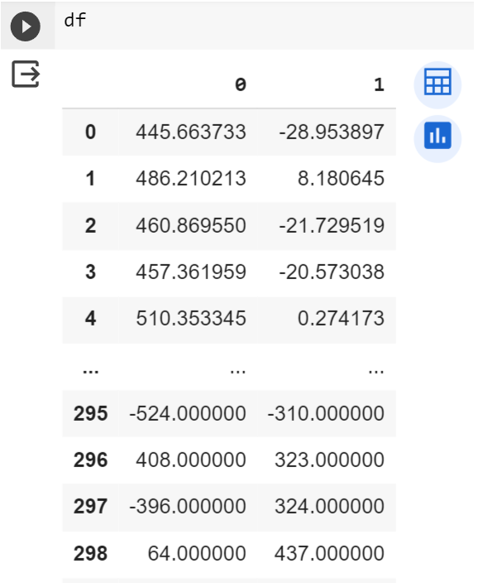
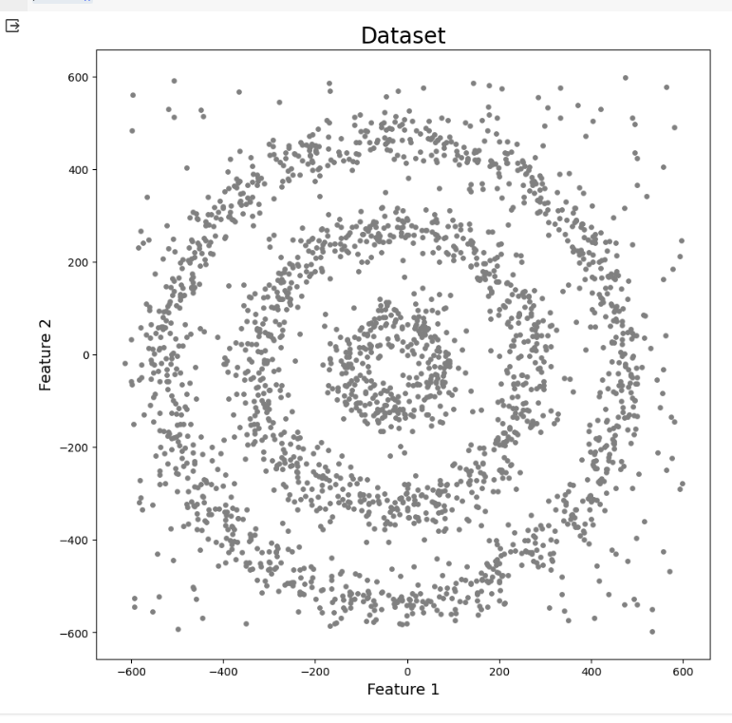
# plotting the data points
plt.figure(figsize=(10,10))
plt.scatter(df[0],df[1],s=15,color='grey')
plt.title('Dataset',fontsize=20)
plt.xlabel('Feature 1',fontsize=14)
plt.ylabel('Feature 2',fontsize=14)
plt.show()
# visualising dataset
df
[Source:https://www.analyticsvidhya.com/blog/2020/09/how-dbscan-clustering-works/]

Slide 26
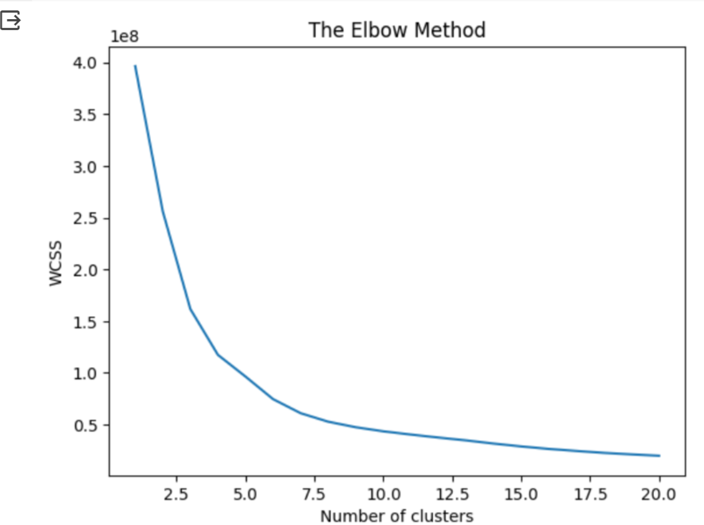
Plotting K-Means clusters
Finding the number of optimal clustering for K-Mean using Elbow Method
from sklearn.cluster import KMeans
wcss = []
for i in range(1,21):
kmeans = KMeans(n_clusters= i, init = 'k-means++', max_iter= 300, n_init= 10)
kmeans.fit(df)
wcss.append(kmeans.inertia_)
plt.plot(range(1,21), wcss)
plt.title("The Elbow Method")
plt.xlabel("Number of clusters")
plt.ylabel("WCSS")
plt.show()
From the elbow curve,
the optimal clusters are 4
Importing KMeans from sklearn and Fitting the model to kmeans
from sklearn.cluster import KMeans
k_means=KMeans(n_clusters=4,random_state=42, n_init=10)
k_means.fit(df[[0,1]])
df['KMeans_labels']=k_means.labels_
[Source:https://www.analyticsvidhya.com/blog/2020/09/how-dbscan-clustering-works/]

Slide 27
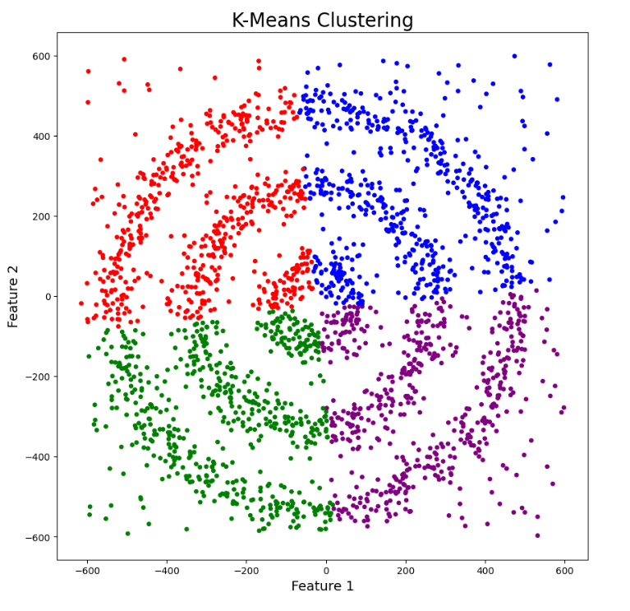
# Plotting resulting clusters
colors=['purple','red','blue','green']
plt.figure(figsize=(10,10))
plt.scatter(df[0],df[1],c=df['KMeans_labels'],cmap=matplotlib.colors.ListedColormap(colors),s=15)
plt.title('K-Means Clustering',fontsize=20)
plt.xlabel('Feature 1',fontsize=14)
plt.ylabel('Feature 2',fontsize=14)
plt.show()
[Source:https://www.analyticsvidhya.com/blog/2020/09/how-dbscan-clustering-works/]

Slide 28
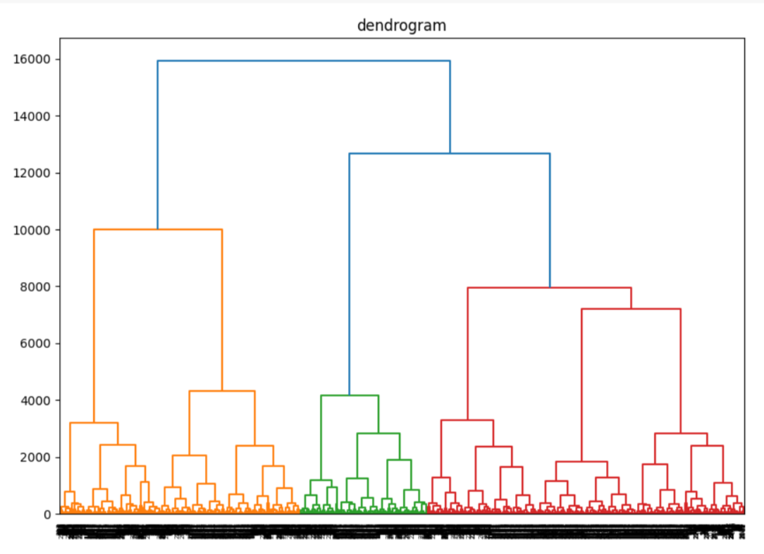
Plotting Hierarchical clusters
Finding the number of optimal clustering for hierarchical using Dendrogram
import scipy.cluster.hierarchy as sch
plt.figure(figsize=(10,7))
dendrogram =sch.dendrogram(sch.linkage(df,method="ward"))
plt.title("dendrogram")
plt.show()
From the dendrogram,
the optimal clusters are 3
Importing Agglomerative clustering from sklearn
and Fitting the model
from sklearn.cluster import AgglomerativeClustering
model = AgglomerativeClustering(n_clusters=3, affinity='euclidean')
model.fit(df[[0,1]])
df['HR_labels']=model.labels_
[Source:https://www.analyticsvidhya.com/blog/2020/09/how-dbscan-clustering-works/]

Slide 29
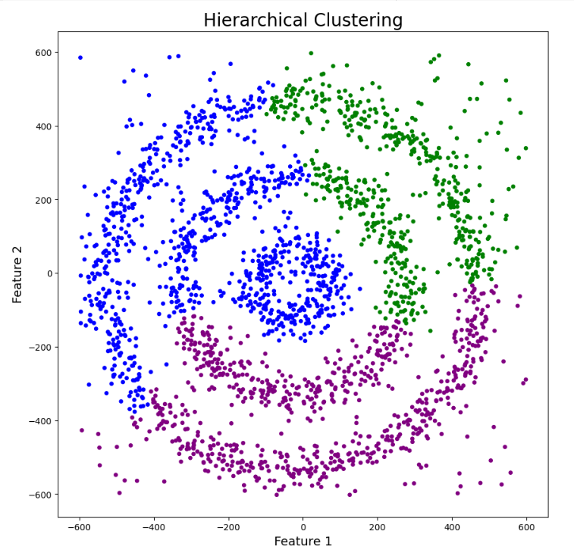
# Plotting resulting clusters
plt.figure(figsize=(10,10))
plt.scatter(df[0],df[1],c=df['HR_labels'],cmap=matplotlib.colors.ListedColormap(colors),s=15)
plt.title('Hierarchical Clustering',fontsize=20)
plt.xlabel('Feature 1',fontsize=14)
plt.ylabel('Feature 2',fontsize=14)
plt.show()
[Source:https://www.analyticsvidhya.com/blog/2020/09/how-dbscan-clustering-works/]

Slide 30
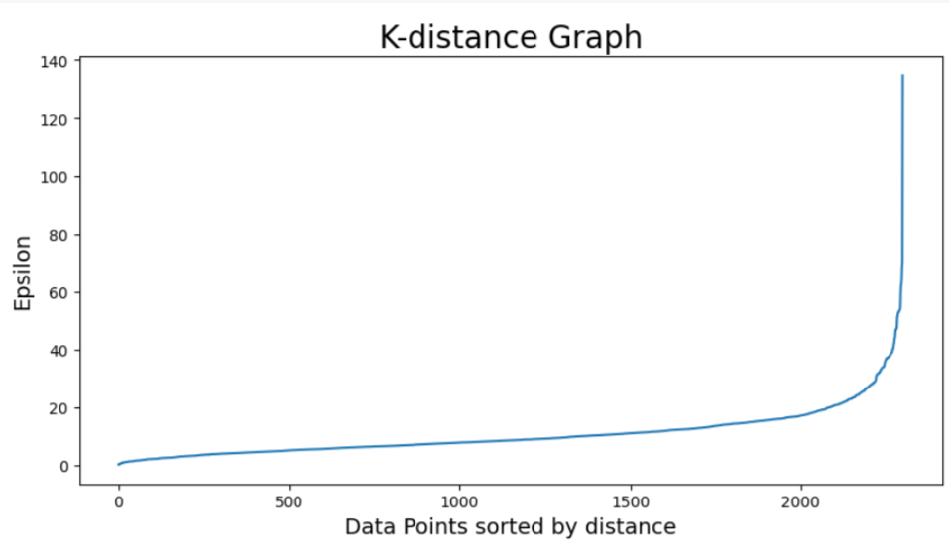
Plotting DBSCAN clusters
Finding the value of EPSILON using K-distance graph
# Plotting K-distance Graph
from sklearn.neighbors import NearestNeighbors
neigh = NearestNeighbors(n_neighbors=2)
nbrs = neigh.fit(df[[0,1]])
distances, indices = nbrs.kneighbors(df[[0,1]])
distances = np.sort(distances, axis=0)
distances = distances[:,1]
plt.figure(figsize=(10,5))
plt.plot(distances)
plt.title('K-distance Graph',fontsize=20)
plt.xlabel('Data Points sorted by distance',fontsize=14)
plt.ylabel('Epsilon',fontsize=14)
plt.show()
Importing DBSCAN from SKlearn
And Fitting the model
from sklearn.cluster import DBSCAN
dbscan_opt=DBSCAN(eps=35,min_samples=5)
dbscan_opt.fit(df[[0,1]])
The Optimal EPSILON value from the graph is 35
And Considering minimum points/samples =5
[Source:https://www.analyticsvidhya.com/blog/2020/09/how-dbscan-clustering-works/]

Slide 31
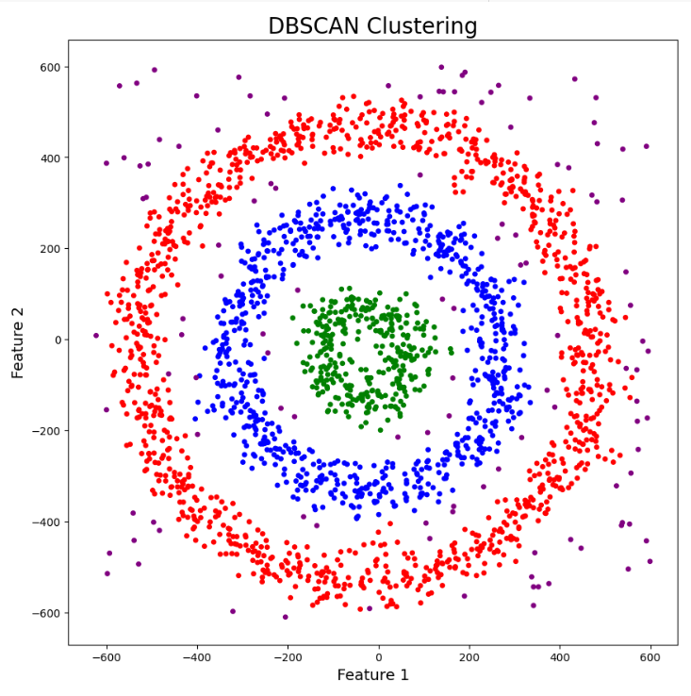
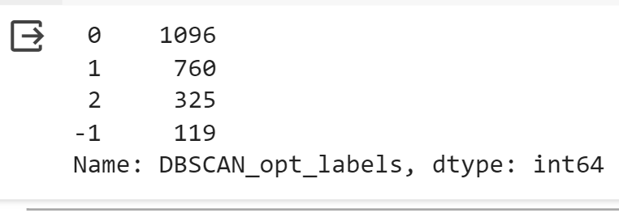
Identifying the cluster using labels count
df['DBSCAN_opt_labels']=dbscan_opt.labels_
df['DBSCAN_opt_labels'].value_counts()
clusters = labels count = 3
Note : Label = -1 indicates Noise
# Plotting the resulting clusters
plt.figure(figsize=(10,10))
plt.scatter(df[0],df[1],c=df['DBSCAN_opt_labels'],cmap=matplotlib.colors.ListedColormap(colors),s=15)
plt.title('DBSCAN Clustering',fontsize=20)
plt.xlabel('Feature 1',fontsize=14)
plt.ylabel('Feature 2',fontsize=14)
plt.show()
[Source:https://www.analyticsvidhya.com/blog/2020/09/how-dbscan-
clustering-works/]

Slide 32
Comparison of all clustering methods:
[Source:https://www.analyticsvidhya.com/blog/2020/09/how-dbscan-clustering-works/]

Slide 33

Hope you have a sweet day (a bloody sweet day)

Slide 34
References
[1] S. Rajbanshi, “Everything you need to know about Machine Learning,” Analytics Vidhya, Mar. 25, 2021. https://tinyurl.com/czks8dn3 (accessed Nov. 10, 2023).
[2] “Clustering with DBSCAN, Clearly Explained!!!,” www.youtube.com. https://youtu.be/RDZUdRSDOok (accessed Aug. 14, 2023).
[3] A. Sharma, “How to Master the Popular DBSCAN Clustering Algorithm for Machine Learning,” Analytics Vidhya, Sep. 07, 2020. https://tinyurl.com/46my4tcf (accessed Nov. 10, 2023).
[4] “DBSCAN Clustering Algorithm Solved Numerical Example in Machine Learning Data Mining Mahesh Huddar,” www.youtube.com. https://tinyurl.com/h7f948b6 (accessed Nov. 10, 2023).
[5] “DBSCAN Clustering Algorithm Explained Simply,” www.youtube.com. https://youtu.be/Lh2pAkNNX1g (accessed Nov. 10, 2023).
[6]“Martin Ester,” Wikipedia, Jun. 22, 2023. https://en.wikipedia.org/wiki/Martin_Ester (accessed Nov. 10, 2023).
[7] “Hans-Peter Kriegel,” Wikipedia, Jan. 30, 2023. https://en.wikipedia.org/wiki/Hans-Peter_Kriegel (accessed Nov. 10, 2023).‌
[8] “Joerg Sander, PhD - Directory@UAlberta,” apps.ualberta.ca. https://apps.ualberta.ca/directory/person/jsander (accessed Nov. 10, 2023).

